Slide 1
ONLINE SHOPPING BEHAVIOR
UNDERSTAND THE CONSUMER TO DEVELOP A BUSINESS STRATEGY FOR ONLINE CLOTHING STORE
(This project is only taken perspective from the online shopping behaviour to understand the online market)

Slide 2
AGENDAS
DATA SOURCE | Survey overall summary
GENERAL ANALYSIS | Tableau Dashboard
HYPOTHESIS | Given 3 hypothesis
AVERAGE TICKET | Who are our target audience
POTENTIAL CUSTOMERS | From the target audience we can see our potential customers
IMPROVEMENTS | What can be improved to have better business strategy

Slide 3

DATA SOURCE
01
03
02
Information collected
JOTFORM.COM
Manual Collection
Gender
Age
Civil Status
Children
Employment Status
Annual Net Income
Internet Hours Spent Per Day
Most Visited Platform
Influencers Follow
10. Buying Under Influence of
Influencers
11. Enjoy Buying Online
12. Values That Influence
Purchase
13. Monthly Spend On Clothing
14. Buying Frequency
15. Percentage of Online Clothes
16. For Whom You Buy
17. Buy On Sale
17 Questions
60 Replies

Slide 4
LET’S HAVE A LOOK AT GENERAL ANALYSIS !
https://public.tableau.com/app/profile/ly.nguyen7178/viz/OnlineShopping_16993052130400/Dashboard1

Slide 5
HYPOTHESIS No.1
(Who you think if people spend more time on the internet, buy more online?)
In this hypothesis testing we will practice hypothesis that involves comparison of 2 groups using t test formula with significance level of 5%:
H0: Average monthly spending on clothes of people that pass 3h/day online
<= Average monthly spending of people that pass less than 3h/day online
H1: Average monthly spending on clothes of people that pass 3h/day online
> Average monthly spending of people that pass less than 3h/day online
Output: pvalue=0.06
The pvalue (6%) > Significance level (5%), it means that the H1 hypothesis is likely correct. However the difference is only 1% so we do not have strong enough evidence to reject the null hypothesis.

Slide 6
HYPOTHESIS No.2
(Do you think that women spend more on clothing than men?)
In this hypothesis testing we will practice hypothesis that involves comparison of 2 groups using t test formula with significance level of 5%:
H0: Average monthly spending of women online <= Average monthly spending of men online
H1: Average monthly spending of women online > Average monthly spending of men online
Output: pvalue=0.02
The pvalue (2%) < Significance level (5%), it means that the data provides significant evidence in favor of the alternative hypothesis. We have enough evidence to reject the null hypothesis.

Slide 7
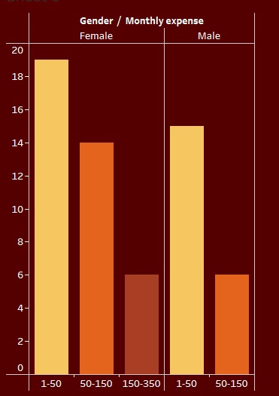
Let’s visualize it

Slide 8
HYPOTHESIS No.3
(Do you think that people with kids spend on clothing more than people without?)
In this hypothesis testing we will practice hypothesis that involves comparison of 2 groups using t test formula with significance level of 5%:
H0: Average monthly spending of people with kids <= Average monthly spending of people without kids
H1: Average monthly spending of people with kids > Average monthly spending of people without kids
Output: pvalue = 8.70669429148653e-07
With a very small p-value (8.70669429148653e-07) compared to a significance level of 0.05, we can reject the null hypothesis. So we can definitely agree that people with kids spend more on clothing than people without kids.

Slide 9
AVERAGE TICKET
(Who is our Target Audience?)
It refers to the average purchase or transaction value, measured by the amount of money spent by a customer during a single visit or purchase
What is it?
How is it created?
Diving how much each person spend per year by the number of times they buy online.
Average Ticket
This will allow us to know how much a person spend on average in a single purchase, so base our business, we will know our target audience
Why do we need this?

Slide 10
POTENTIAL CUSTOMERS
Creating dummies
Creating dummies for the "Average ticket" variable is our strategy to categorize or group customers based on their spending behavior. We are trying to identify and target specific customer segments or behavior to create more personalized marketing campaigns
Dumming all categorical values → Create First Ticket with a range 100-300 spending → Identify who are the potential customers
Dumming all categorical values → Create Second Ticket with a range above 300 spending → Identify who are the potential customers

Slide 11

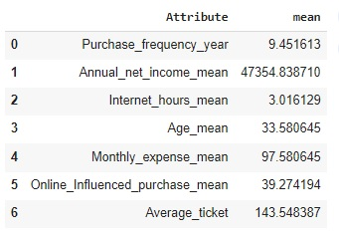
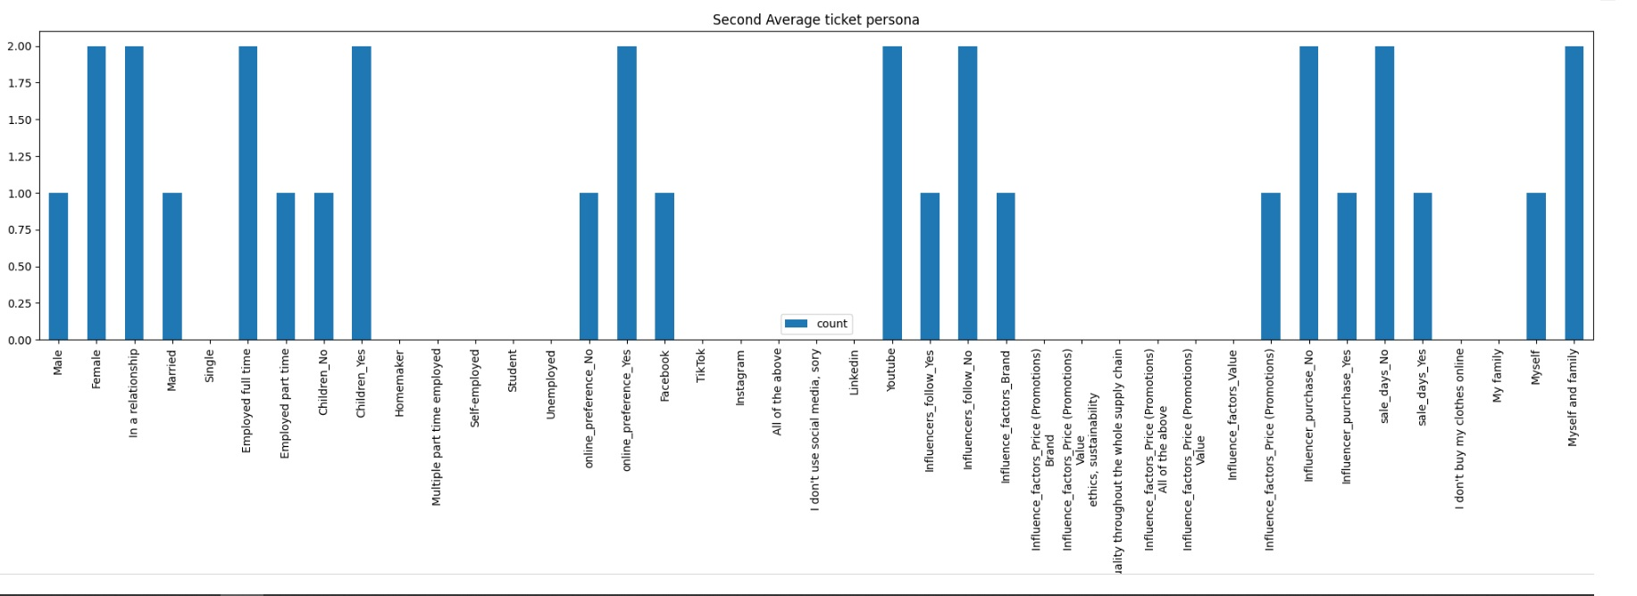
Potential Customer No.1
(Average Ticket 100-300)

Slide 12

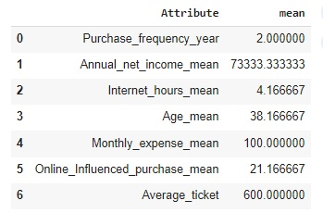
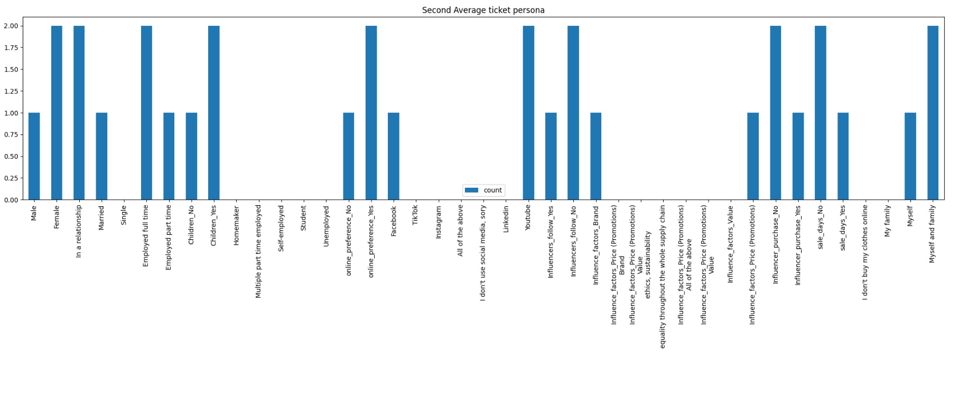
Potential Customer No.2
(Average Ticket Above 300)

Slide 13
IMPROVEMENTS
Better Time Management
More Data
Better Survey Questions
Correlation Matrix
Business Sales Prediction

Slide 14
THANK YOU

